Slide 1
wonder.land - lighting
Archie

Slide 2
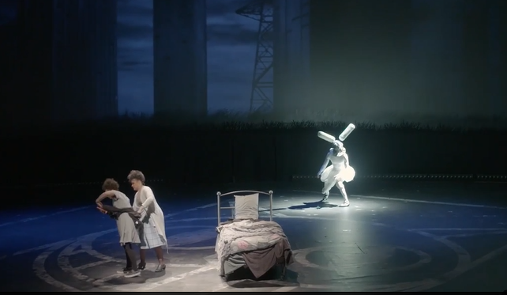
The Rabbit
White colour - Blends in with the monochrome color of the stage.
Brighter Spotlight - While still blending the Rabbit with the rest of the stage, it gives the character variation with the real world and doesn’t blend it in too much. It also exaggerates the invisibility to everyone but Aly.
Flickering - similar sort of thing found in some 8-bit games, as well as this there are the noises.

Slide 3
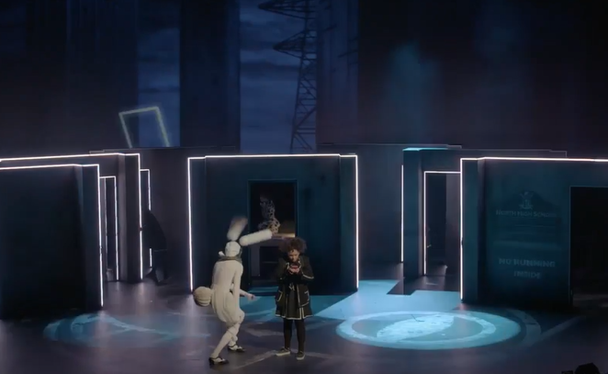
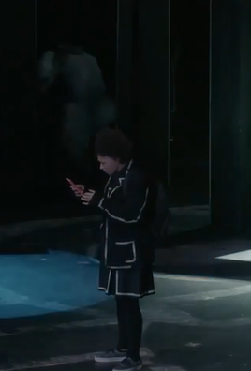
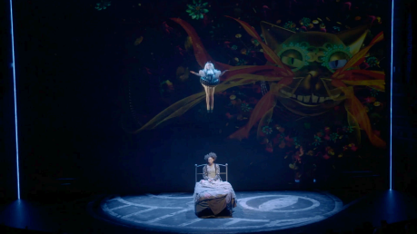
The blue light works with the dark colours on the stage and also is one of the colours used to represent wonder.land in other scenes.
The LEDs on the walls flash again showing that strobe light effect used to represent wonder.land in the early scenes.
When the Rabbit leaves, the light surrounding him goes and Aly comes off her phone.
The blue lights surround both Aly and the rabbit showing that they are both in wonderland (until the head comes in).

Slide 4
Use of lighting is good overall.
Uses colours well.
Effects such as strobe lights and different brightness.
Emphasises aspects of the actual performance.

